Slide 1
Magnetism
Cause and Effect

Slide 2
Relations…
Magnetism is directly related to electricity
Magnetic materials exhibit magnetism because of the alignment of the spins of their electrons
A section of a material where electrons spin in the same direction is called a magnetic domain.

Slide 3
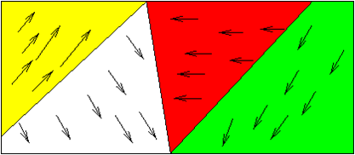
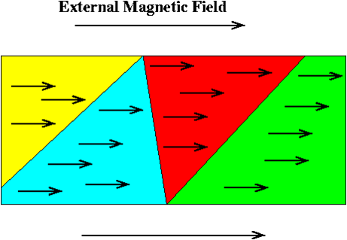
Demesnes
The “domains” of a nonmagnetized material are disorganized
The “domains” of a magnetized material are organized

Slide 4
Pole to pole…
Areas of magnetic fields that concentrate magnetic forces are called magnetic poles.
There is no such thing as a monopole magnet; all magnets must have both a North and a South pole
Magnetic poles also follow the “Opposites attract; Likes repel” rule.
S
N
S
N
S
N

Slide 5
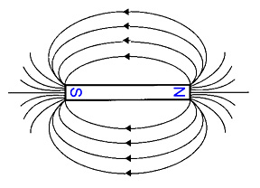
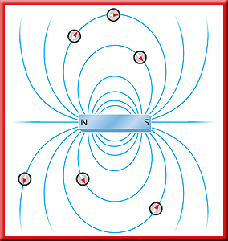
I’m hooked on a feeling…
A magnetic field is the area over which a magnetic pole can apply a force for an effect
Magnetic fields look exactly like electrical fields

Slide 6
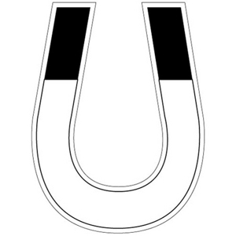
Horseshoe Magnet
Bringing the opposing poles closer strengthens the magnetic field

Slide 7
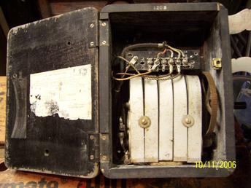
Inside an old phone
As you crank the handle, a wire coil is turned inside several strong horseshoe magnets
HAND CRANK
GEARS
HORSESHOE MAGNETS

Slide 8
I’m a wanderer, a wanderer…
Earth’s spinning liquid metal core creates a magnetic field around the Earth.

Slide 9
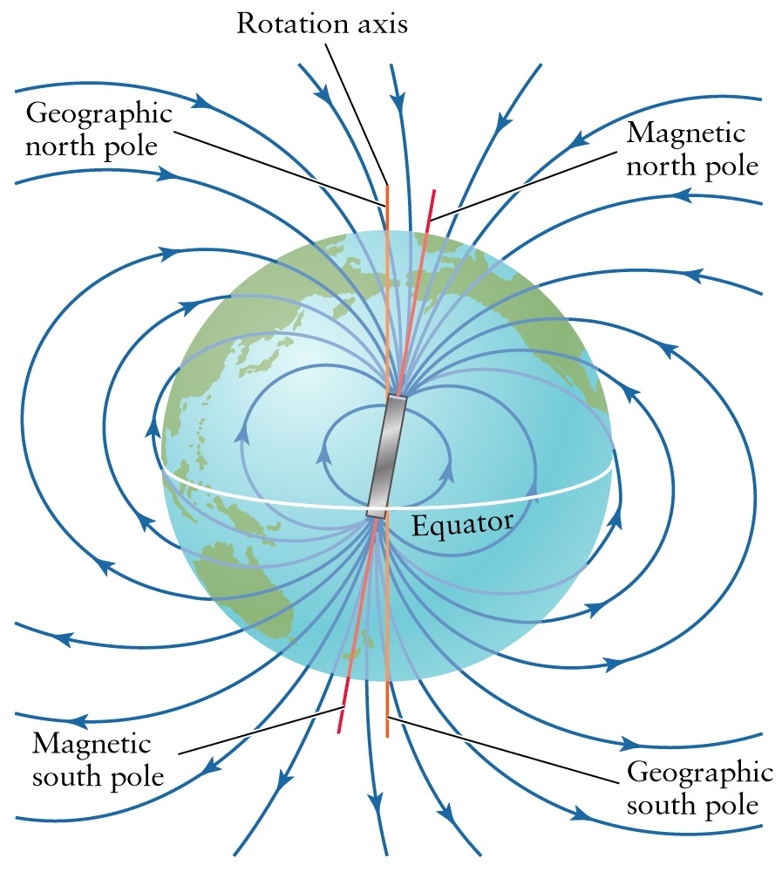
The “north pole” is really a “south pole”
WHY?
Notice that Earth’s North and South GEOGRAPHIC POLES are not aligned with the Earth’s MAGNETIC POLES!

Slide 10
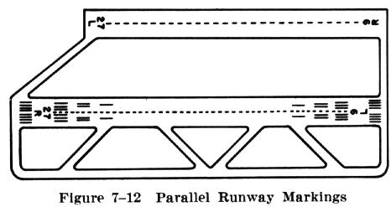
The difference between the magnetic and geographic poles means that your compass doesn’t point to TRUE NORTH
Airports have recently had to repaint their runways
  The numbers on a runway indicate direction
  Even though the runway didn’t move, their direction has changed

Slide 11
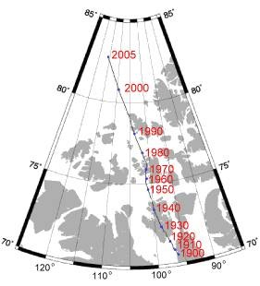
EARTH’S WANDERING POLE!!
is accelerating!!

Slide 12
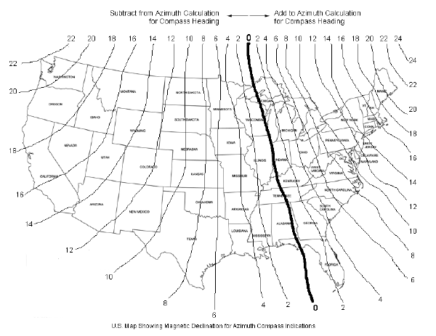
1988

Slide 13
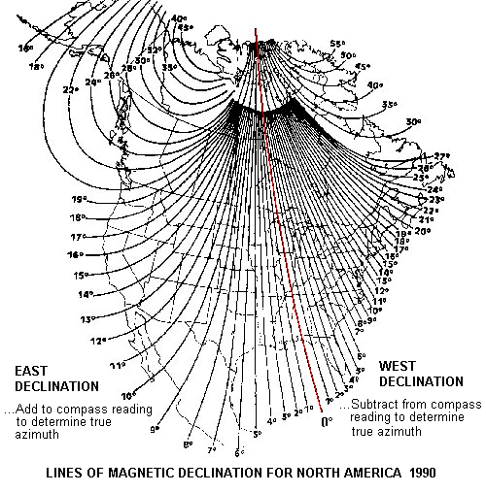
1990

Slide 14
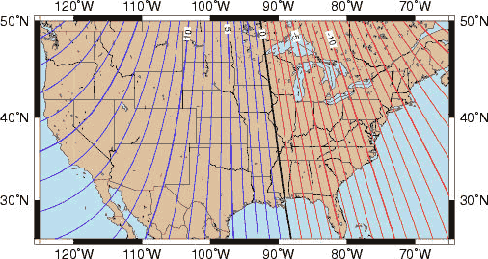
2005

Slide 15
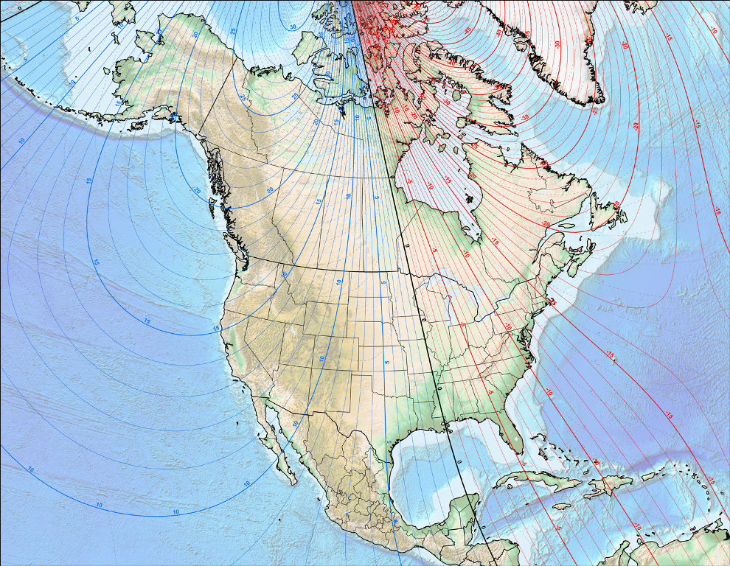
2010

Slide 16
Electromagnets
Hans Christian Oersted discovered that a wire carrying a current produces a magnetic field
An electromagnet produces a strong, temporary magnet using electricity
Three parts:
  Solenoid – a coil of wire
  Iron Core – a mass of ferromagnetic material inside the solenoid
  EMF – some source for electric current

Slide 17
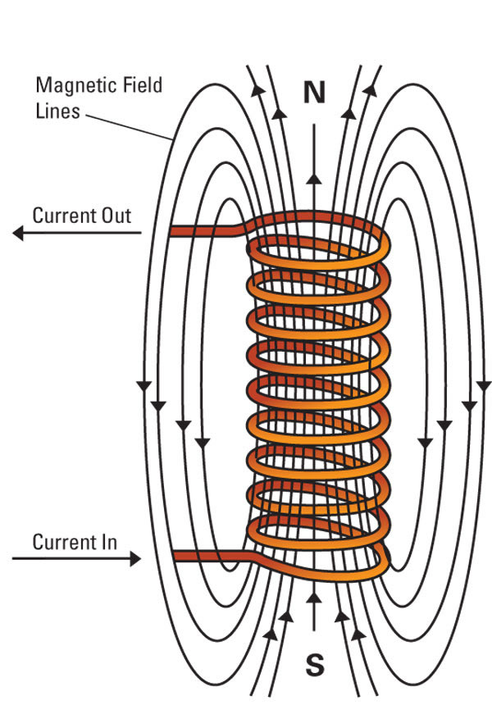
A solenoid without a core still produces a magnetic field.
The more loops of wire there are, the stronger the magnetic field.

Slide 18
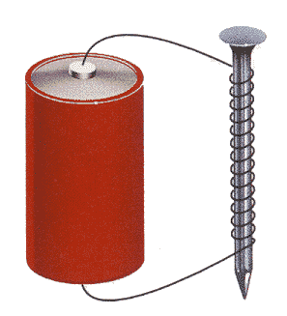
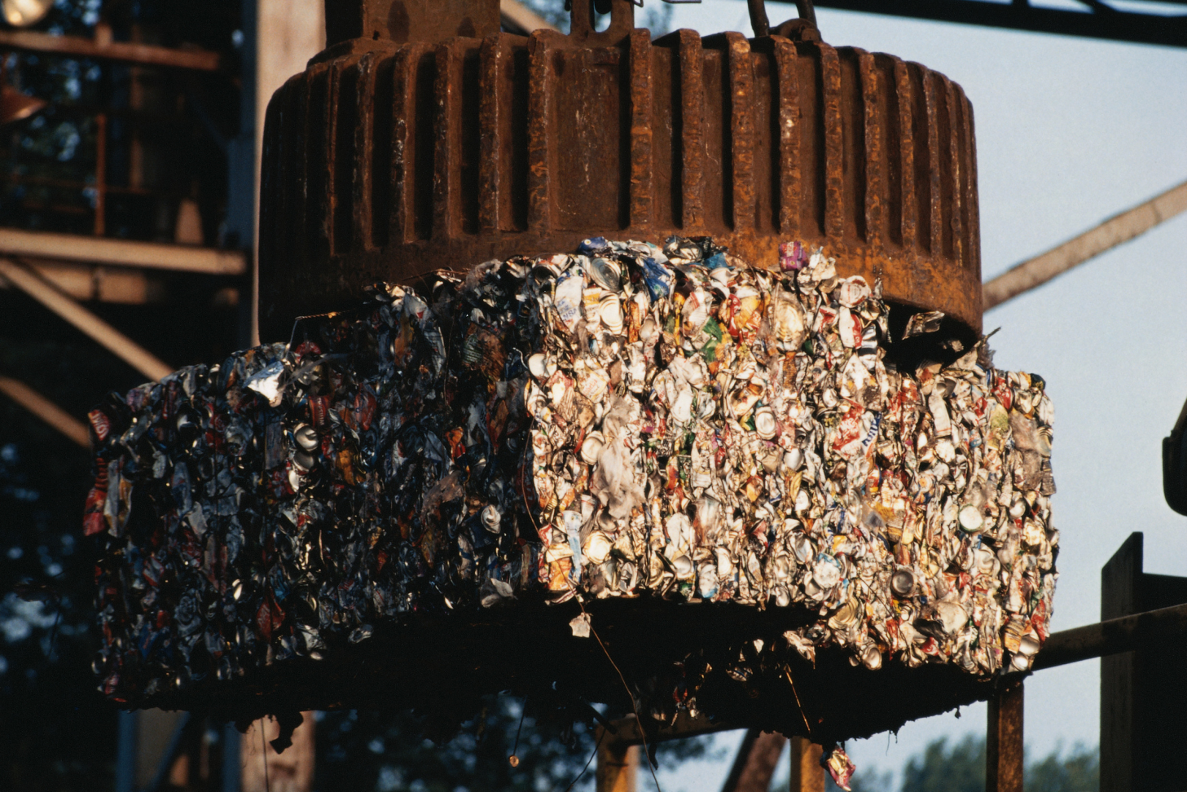
Increasing the amount of ferromagnetic material in the core increases the strength of the magnetic field

Slide 19
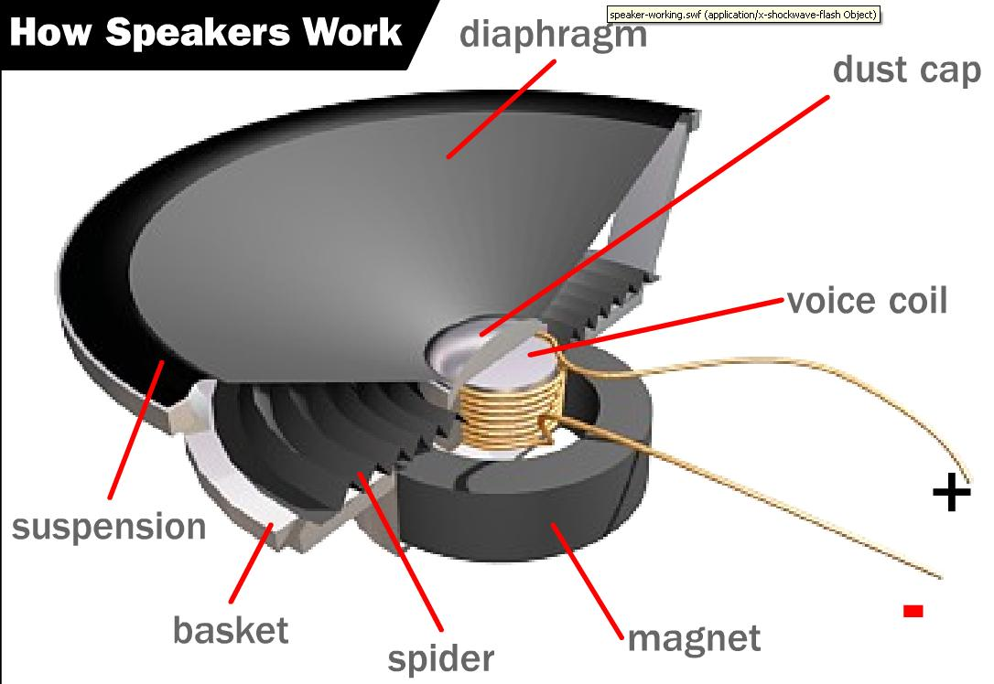
The frequency of the music is translated as a frequency of pulses of electricity
The pulses change the polarity of the coil, causing forces with the permanent magnet
These forces vibrate the diaphragm, producing sound waves

Slide 20
Three ways…
Name and describe the three ways to strengthen an electromagnet

Slide 21
Measure for measure…
The strengthening of an electromagnet is proportional
Doubling the number of wires doubles the strength
Halving the amount of core material halves the strength, etc.
Normally, the structure (solenoid and core) remains the same, and the voltage is varied to vary the strength

Slide 22
Motoring
An Electric Motor converts electrical energy (current and voltage) into Mechanical Energy (push and pull)
This allows work in one area (a generator) to be transmitted to do work in another area (an electric fan)

Slide 23
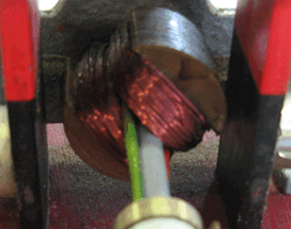
Electric Motors
A motor consists of two main parts:
  An unmoving outer “shell” permanent magnet called the stator
  A rotating inner electromagnet called the rotor
    The rotor may be part of a larger mechanism (razor blades, fan blades) and called an armature

Slide 24
Turn, turn, turn
To get the rotor to turn, you must change the poles of the magnets to consistently apply “likes repel”
  An Alternating Current motor will change the poles as the current changes direction
    In the US, this occurs 60 times each second
    Contact is maintained by “slip rings”

Slide 25
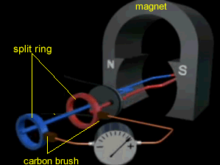
AC Motor

Slide 26
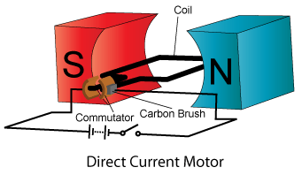
Flip-Flop
  A Direct Current motor uses a commutator
    As the commutator’s halves slide across a “brush”
      Positive or negative
    that end of the electromagnet takes on a particular pole (north or south)
  The commutator makes the end of the electromagnet the same every pass, consistently applying “likes repel” forces

Slide 27
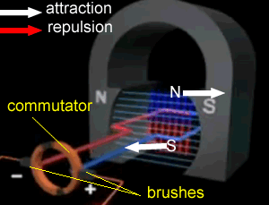
DC Motor

Slide 28
I can relate…
A generator converts mechanical energy to electrical energy
  a “push” or “pull” into the movement of electrons
Also called Electromagnetic Induction
Alternating Current is easier to produce because the ends of the rotor naturally pass opposite ends of the magnet.

Slide 29
I got more rhymes than The
Michael Faraday found out that turning a wire inside of a magnetic field causes the electrons to “jump”
This movement of electrons can be channeled to become current
  How strongly the electrons jump is voltage
  How many electrons jump is current

Slide 30
I like to move it, move it
Improving a generator
  More coils of wire means each wire crosses a magnetic field line more frequently, producing more current
  A stronger stator magnet means
    More field lines, so more electrons jump
    Stronger field lines, so the electrons jump “harder”

Slide 31
More than meets the eye…
A transformer can change the voltage and current carried in a wire
ONLY WORKS ON AC CURRENT
  The changing direction of the current changes the magnetic field of the wires and changes the N-S poles

Slide 32
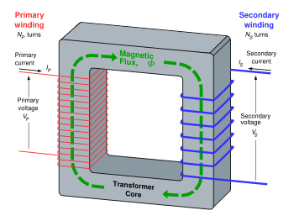
It’s what’s inside that counts…

Slide 33
Step it up!
A Step-Up transformer has more turns on the secondary coil
A Step-Down transformer has more turns on the primary coil

